Slide 1
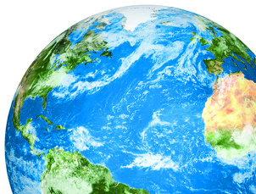
Setting the Stage: What does the science tell us?
Oceans Day, UNFCCC COP21, Paris 2015
Dr Carol Turley OBE

Slide 2
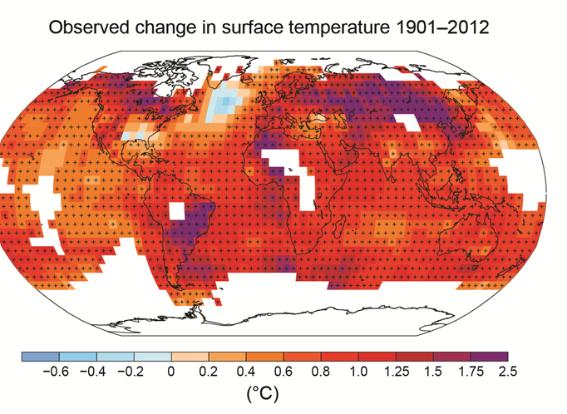
The ocean is absorbing nearly all the heat from global warming: …..causing it to warm
93% of heat
Ocean warming
IPCC AR5 2014

Slide 3
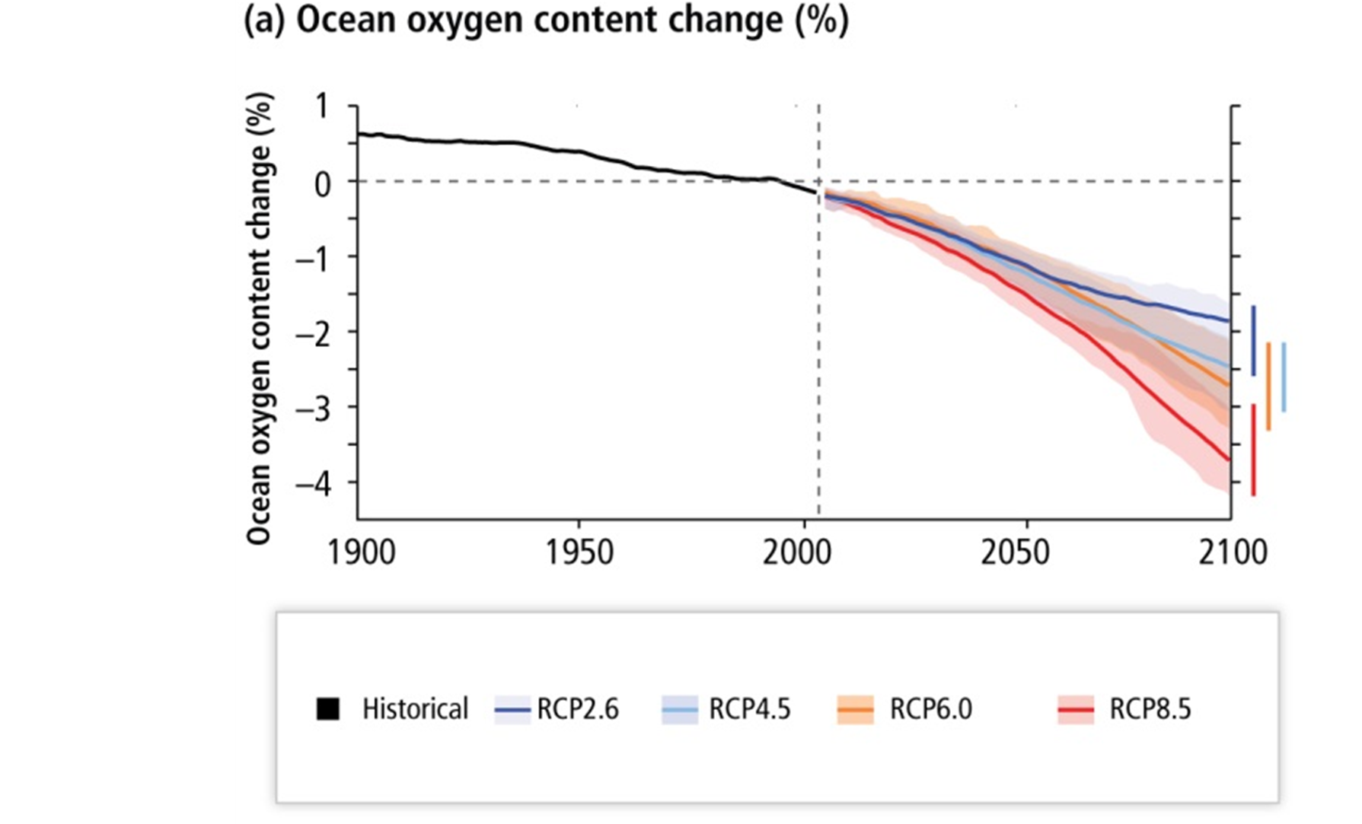
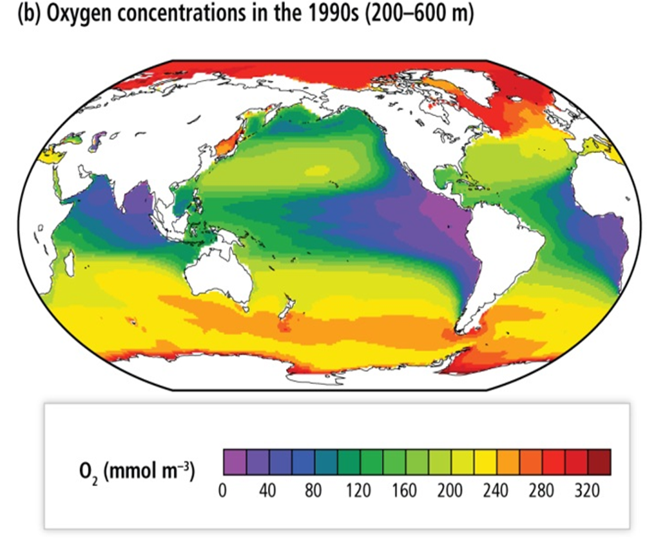
Ocean oxygen concentrations are decreasing: …due to warming waters increasing stratification … dead zones with low oxygen will increase
IPCC AR5 2014

Slide 4
The ocean receives all the water from melting ice:
…. along with thermal expansion, resulting in sea level rise
100% of water
Sea level rise
Image credit: UKOA, Sea Surface Consortium

Slide 5
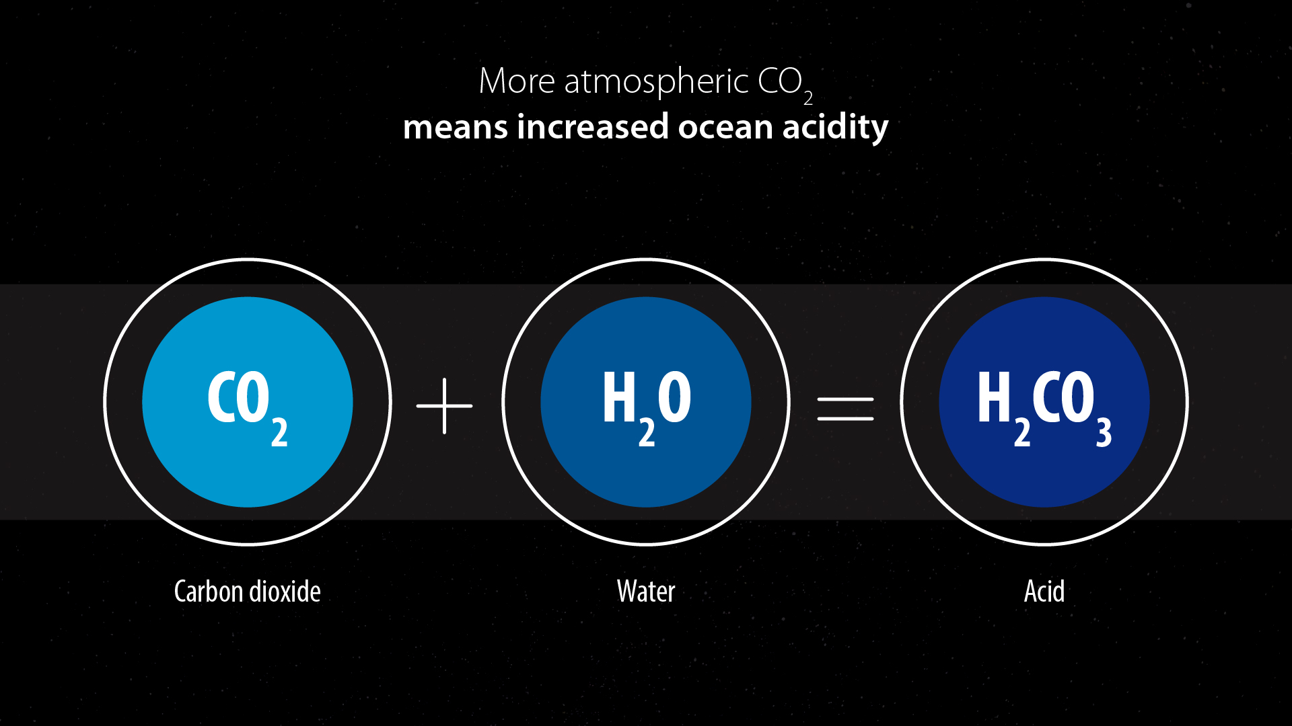
The ocean takes up 28% of carbon dioxide emissions: …. reducing atmospheric warming but causing ocean acidification
28% of CO₂
Ocean Acidification
Notes:
9. When this CO2 is taken up by the ocean it forms an acid – carbonic acid, so lowering the pH by increasing hydrogen ions, the measure of acidity, of

Slide 6
These stressors are happening at the same time increasing risk to the ocean
Notes:
21. Unfortunately, ocean acidification is not the only risk facing our ocean! What all this research and more has shown is that ocean warming and sea level rise are happening at the same time as acidification –
a. they are acting together, often stacking the stress on marine ecosystems – increasing the risk.
b. If CO2 emissions keep on going at the same rate, the High CO2 scenario (shown on the right), seas will be 3oC warmer on average, pH will be 0.4 units lower and sea levels 0.86 m higher by the end of this century.
c. However if we make serious cuts to our emissions (shown on the left) we can keep these changes much lower.

Slide 7
Notes:
22. The risk of these multiply stressors to many key ecosystems (such as coral reefs, seagrasses, bivalve shell fish, krill and fin fish) of high carbon emissions will be high or very high ( seen on the right) but are greatly lowered if we have low carbon emissions (left).

Slide 8
Notes:
23. With high carbon emissions the risk to goods and services (such as coastal protection, coral reef recreation, aquaculture and fisheries) that ecosystems provide will be high or very high.
a. Low carbon emissions, shown on the left, would reduce the risk considerably.
b. Further research is needed to predict what future ocean ecosystems may look like and provide us with when all these stressors occur at one time.

Slide 9
The ocean will change but reducing CO₂ emissions will make a difference:
2ºC Limit

Slide 10
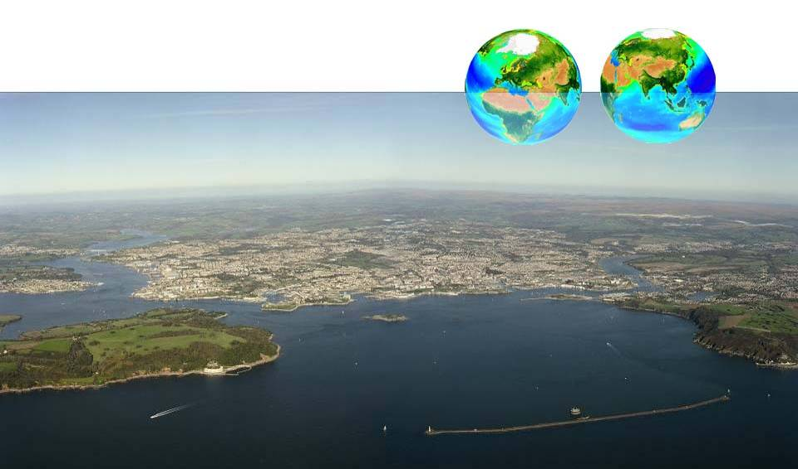
Opportunity to reduce the risk - Thank you ct@pml.ac.uk

